Slide 1
S.M.A.R.T. Goals and Objectives (Review)
INSTRUCTIONS:
1) Change Goal into SMART goal (specific, measurable, achievable, realistic, timebound)
2) Create 3 SMART objectives for the goal
Apply to companies
Send resumes
Network
Notes:
You can make program/industry specific guidelines / goals

Slide 2

The Hidden Job Market

Slide 3
The Hidden Job Market
The hidden job market can represent up to 80% of the job market (meaning 80% of jobs are never advertised)
So how do you “find” the hidden job market? NETWORKING!
http://canadianimmigrant.ca/work-and-education/howto-find-a-job/crack-the-hidden-job-market-with-these-seven-secrets
http://talentegg.ca/incubator/2014/08/18/hidden-job-market/

Slide 4
Consider this…
You are the Manager at a company and supervise a team of 10 staff members. The Team Lead quits one day and you need to replace them as soon as possible. Where do you look first to start the hiring process? What do you do?

Slide 5
How managers hire…
1. Promote from within
Any qualified/eligible staff currently?
Post the position within the company
2. Staff referrals → NETWORKING
Do current staff have recommendations?
Referrals from other departments or companies
3. Resumes on file → WALK INS
Resumes dropped off/e-mailed previously
Previous applications submitted
4. Advertise position to public
Posting position on-line or on company web site
Flyers, job fairs, interviewing, hiring, training etc.

Slide 6
THE PASSIVE APPROACH TO JOB SEARCH
Monitor the myCareer System
Attend the myCareer Showcases
Apply to posted positions on-line
Why are these “passive” approaches?

Slide 7
THE ACTIVE APPROACH
Network! Network! Network!
Events / Networking Cards
Informational interviews
Core program faculty
Associations
The WHY? WHO? & HOW? of Networking
Do not spend your time going over territory already covered
Research (more links at the end of presentation)
Business Directories for specific cities
Job search websites (i.e. www.indeed.ca; www.coopjobs.ca; www.wowjobs.ca; www.talentegg.ca )
Company websites
Direct Employer Contact
Cold Calls / Emails
Attend information sessions
myCareer Showcase
Job Fairs

Slide 8

Networking Card Example:
You can customize your LinkedIn link. Helpful especially if you have a common name- makes it easier for employer to find you.

Slide 9
THE ACTIVE APPROACH
Utilize the Resources & Support System Available to you!
myCareer Services
Meet with Co-op and Career Advisor
Bring completed Action Plan to the meeting
Program capability sheets
Resume/cover letter review
Mock interviews
Optimal Resume Suite
Resumes; Letters; Interview prep.; e-portfolios etc.

Slide 10
Informational Interviews
An informational interview is an interview conducted to collect information about a job, career field, industry or company.
http://www.quintcareers.com/informational_interviewing.html

Slide 11
Informational Interviews
Benefits:
Relevant information from individual working in field
Learn about career paths you didn’t know existed
Information about specific organization
Tips on targeting resume to company and interview skills
Expand network from people in same field

Slide 12
Informational Interview
Initiate Contact
Mention how you gained contact
Emphasize you’re looking for information NOT a job / co-op
Request for time ~20-30min appointment
Prepare questions

Slide 13
Informational Interview
Sample Questions: Start here:
What kind of duties do you do?
What percentage of your time is spent doing that?
Why did you decide to work for this company?
What sort of changes are occurring in your occupation
Then go into more detail:
What are the major qualifications for success in this occupation?
How would you describe the working environment and people with whom you work?
Do you have any advice for someone new entering this field?

Slide 14
Job/Career Fairs – What to Expect?
Where will they be held?
Community/rec centers, gyms, halls, etc.
All over the city
Who will be there?
Managers, Supervisors, HR Managers, Recruiters, current staff members, etc.
What to prepare?
Many copies of your resume, basic interview answers
Be prepared to sell yourself!
Purpose?
To network, apply for jobs, explore new companies, get advice from employers, explore new opportunities and the list goes on and on!
How do I find them?
Peters New Jobs - http://www.petersnewjobs.com/toronto-employment-events-and-organizations.html
Canada Job Expo - http://canadajobexpo.com/

Slide 15
Job Fair Etiquette
Register for the event in advance
Come prepared to interview: prepare interview answers, attire and a positive attitude!
Do not go with a friend or family!!! (Employers like to see independent and mature candidates)
Show the employers you are interested!
Collect business cards and contact information – follow up with employers
Plan to spend time at the booths and ask the employers questions!

Slide 16
Apply These to Your Job Search
Be Proactive
Begin With the End in Mind
Put First Things First
Think Win/Win
Seek First to Understand and then to be Understood
Synergize
Sharpen the Saw

Slide 17
myCareer System
https://mycareer.lambtoncollege.ca/home.htm
Review job postings, part-time, summer, volunteer, co-op and graduate employment opportunities
NOTE: Please see the myCareer Centre Job Posting Terms & Conditions for your reference
Apply for jobs (if requested by the employer)
View the events calendar, register for upcoming events
Setup appointments with your Co-op Advisor - all via the Internet

Slide 18

7 Habits of Highly Effective People
presents an approach to being effective in attaining goals by aligning oneself to what he calls "true north" principles of a character ethic that he presents as universal and timeless
Outlines 7 different habits people should adopt to make them more effective in everything they do
https://en.wikipedia.org/wiki/The_7_Habits_of_Highly_Effective_People

Slide 19
7 Habits & Your Job Search
7 Habits of Highly Effective Job Seekers
https://www.huffingtonpost.com/susan-p-joyce/7-habits-of-highly-effect_b_5823490.html
Article explains how to apply the 7 Habits of Highly Effective People to your co-op search
Notes:
In-Class activity idea: split students into 7 groups; each group researches 1 habit and explains how habit could be used for co-op search. Each group has one student present and teach the rest of the class.

Slide 20
Habit 1– Be Proactive
Referred to as the habit of CHOICE
See alternatives not roadblocks
Focus on the things you can influence rather than what you don’t have control over
Believe you are free to choose and that you are responsible for the choices that you make
Take responsibility for your own life and what happens to you

Slide 21
Habit 2 – Begin with the end in Mind
Referred to as the habit of VISION
Envision what you want in the future so you can what you want to make a reality
Set your end goal and work backwards
Set goals and objectives that lead you to achieving this, align your actions with the mission you have developed
Hold a clear image as to where you want to go and understand the current position to keep moving in that direction

Slide 22
Habit 3 – Put first things first
Referred to as the habit of INTEGRITY AND EXECUTION
Focus on the important, not just the urgent
Effectiveness requires the integrity to action on your priorities
Plan weekly, act daily
Proper time management is important for personal effectiveness

Slide 23
Habit 4 – Think win win
Referred to as the habit of MUTUAL BENEFIT
Work towards building trust with people, this requires mutual respect
Effective long term relationships are built on mutual respect and mutual benefit
No one wants to be taken advantage of or taken for granted
See life as an opportunity for cooperation not competition

Slide 24
Habit 5 – Seek first to understand and then be understood
Referred to as the habit of MUTUAL UNDERSTANDING
To communicate effectively we must first understand each other
Proactive empathetic listening – intending to understand what the other is trying to communicate
Give honest, accurate feedback

Slide 25
Habit 6 – Synergize
Referred to as the habit of CREATIVE COOPERATION
The whole is greater than the sum of its parts
Attempt to pool all the differences into one unified effort
“two heads are better than one”
Value peoples differences

Slide 26
Habit 7 – Sharpen the saw
Referred to as the habit of RENEWAL
Renew the 4 dimensions of your nature – physical, spiritual, mental and social/emotional you can be more productive
Take time our for personal maintenance
Expand your mind with new ideas and information regularly

Slide 27
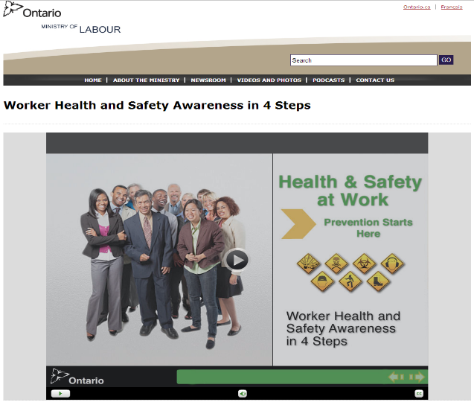
Week #6 – Online Work
Submit: myCareer System
login into the system
find any job, save and upload the posting to Moodle
Read and Review:
Safety in the Workplace PowerPoints (provided on Moodle)
Complete and Submit:
Worker Health and Safety Awareness Certificate (PDF version – upload to Moodle)

